Slide 1
Exposys Data Labs
We would like to thank exposys data labs for giving us the opportunity.
Project Developers: Perina. Poorna Saiteja Pabbathi. Sai Vasu Tarun Kumar
Founder & CEO : Vishnu Vardhan Y
Email: hr@exposysdata.com
Website: http://exposysdata.com/

Slide 2
College Administration System
Presented by :-
Perina.Poorna Saiteja
Pabbathi.Sai Vasu Tarun Kumar

Slide 3
INDEX
Problem Definition
Existing Problem
Proposed Solution
Software and Hardware requirements
Modules of the project
Results of the project
Conclusion and future work

Slide 4
Problem Definition
The main objective of developing the current project entitled “College Administration System” is to build effective system which can maintain attendance , marks of students so that it can incorporate any future enhancements.
Providing Login id’s for students and staff members.
Every user such as student, staff and administration can able to see the information of each student through online from anywhere and anytime.

Slide 5
Existing Problem
Maintaining the records manually leads to error prone and required more man power and it consumes more time for processing the records.
Unable to view the full attendance report of semesters through online .
Unable to analyse student marks of all semesters .
Fee activity of students is not shown .

Slide 6
Solution
Build a Student portal which provides attendance activity of students through Graphical User Interface(GUI) to mark attendance of students .
To know the marks of various semesters at one place for better analysis.
Fee activity of students in which dues can also be seen.

Slide 7
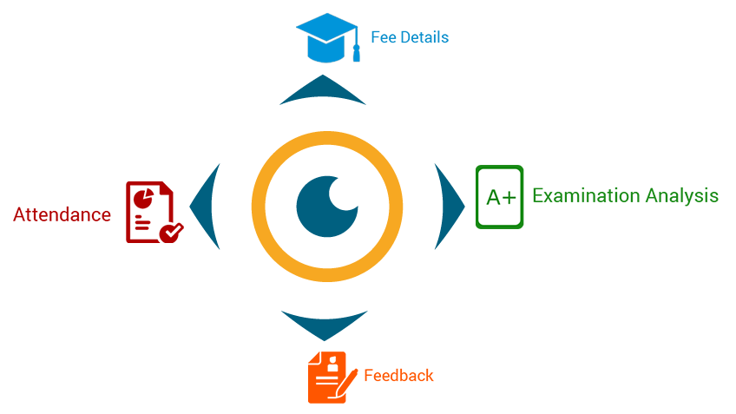

Slide 8
Hardware Requirements
System : Pentium Dual Core
Hard disk : 120 GB
RAM : 2 GB or more
Monitor
Mouse

Slide 9
Software Requirements
O/S : Windows
Python3
Django

Slide 10

Technologies used for implementation
HTML
CSS
BOOTSTRAP
DJANGO

Slide 11

Django
Django is a web development framework that assists
in building and maintaining quality web applications.
Django helps eliminate repetitive tasks making the
development process an easy and time saving
experience.

Slide 12
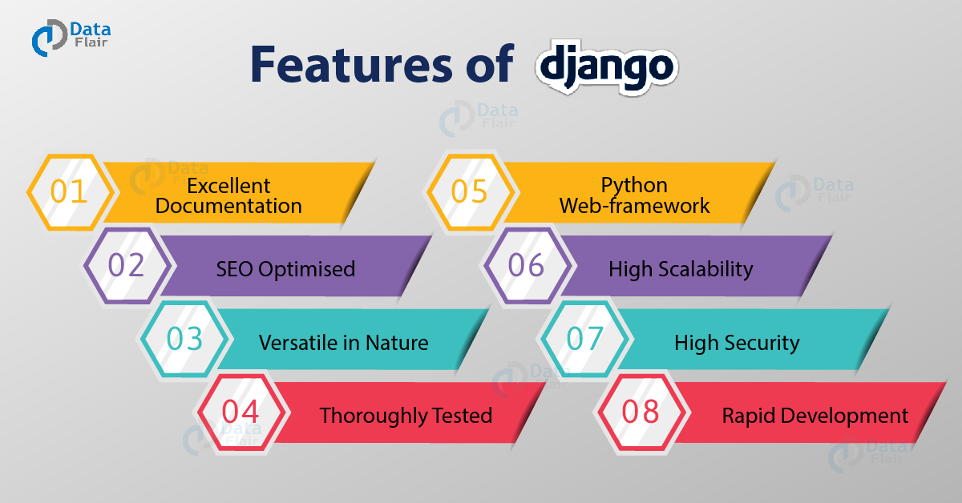

Slide 13
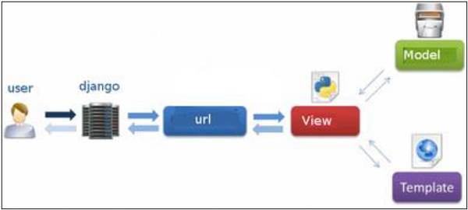
CONTD…
Django MVT Pattern : Model , View , Template.

Slide 15
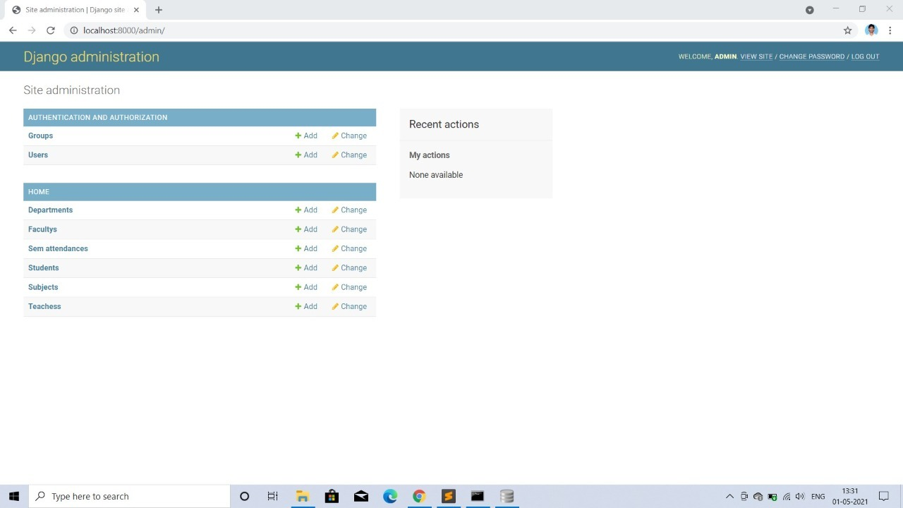

Slide 16
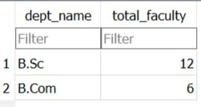
Department

Slide 17
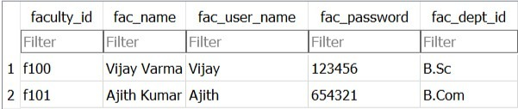
Faculty

Slide 18
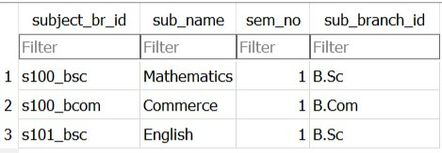
Subjects

Slide 19
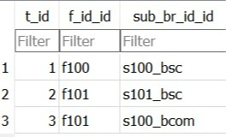
Teacher

Slide 20
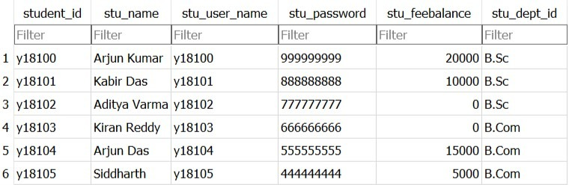
Student

Slide 21
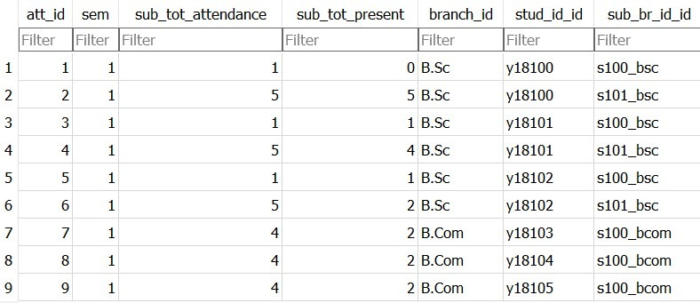
Sem attendance

Slide 22
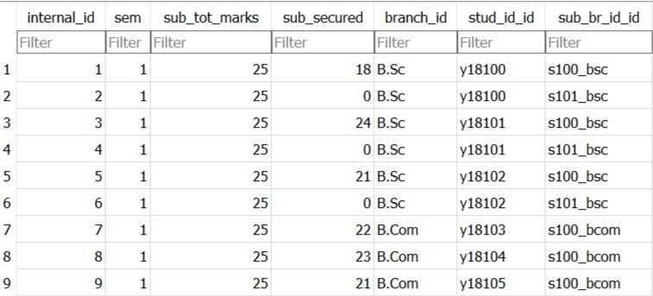
Internal marks

Slide 23
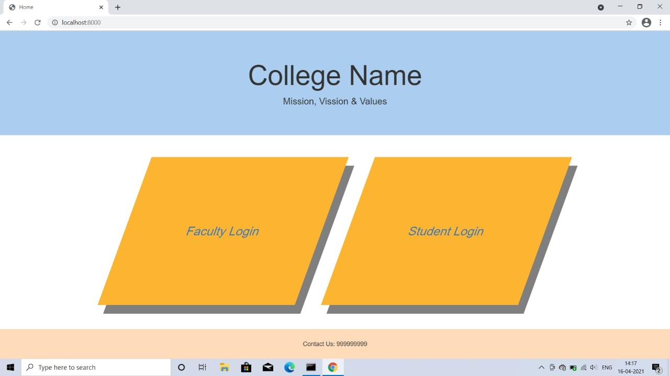
Results

Slide 24
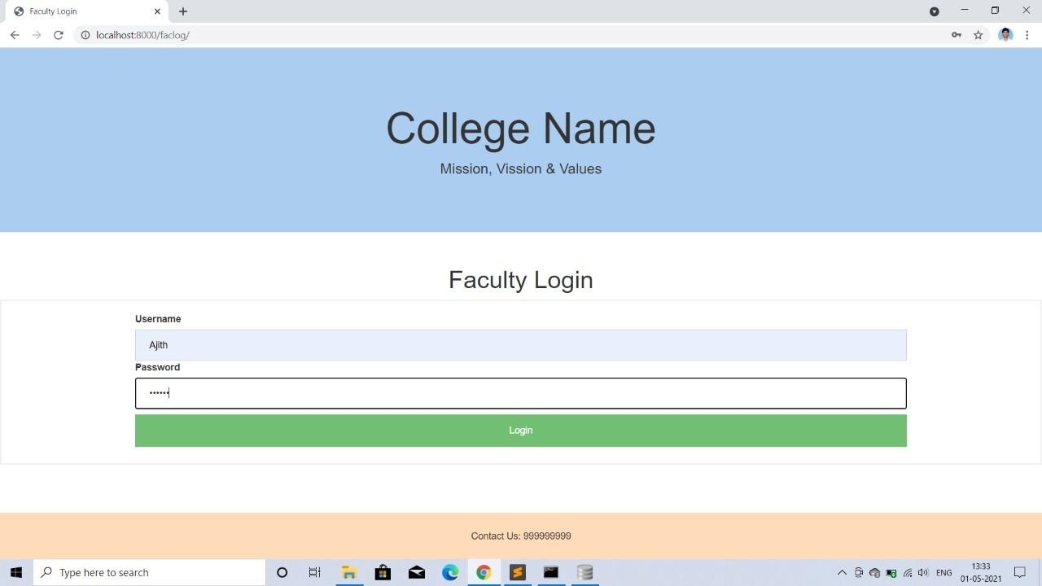

Slide 25
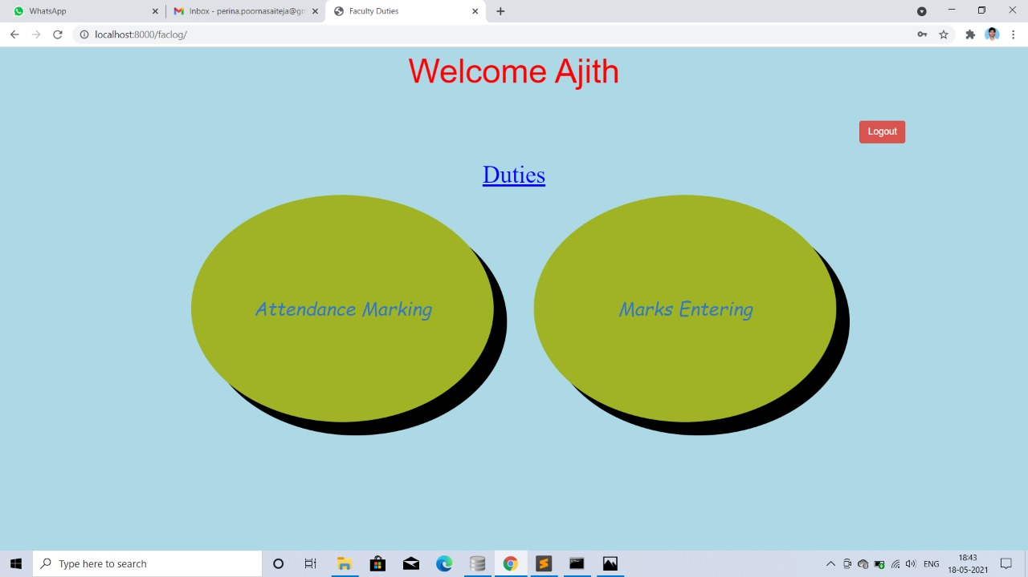

Slide 26
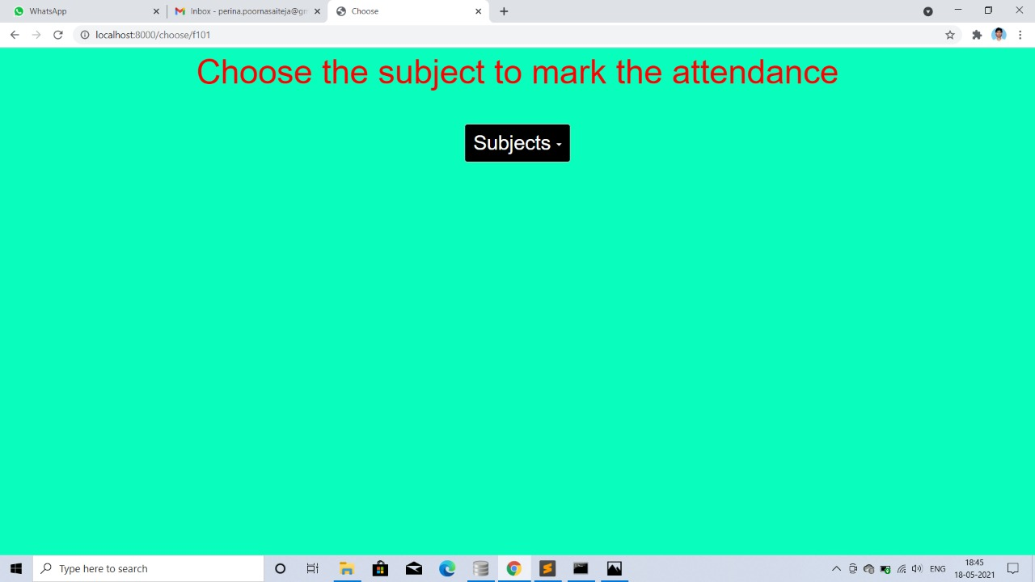

Slide 27
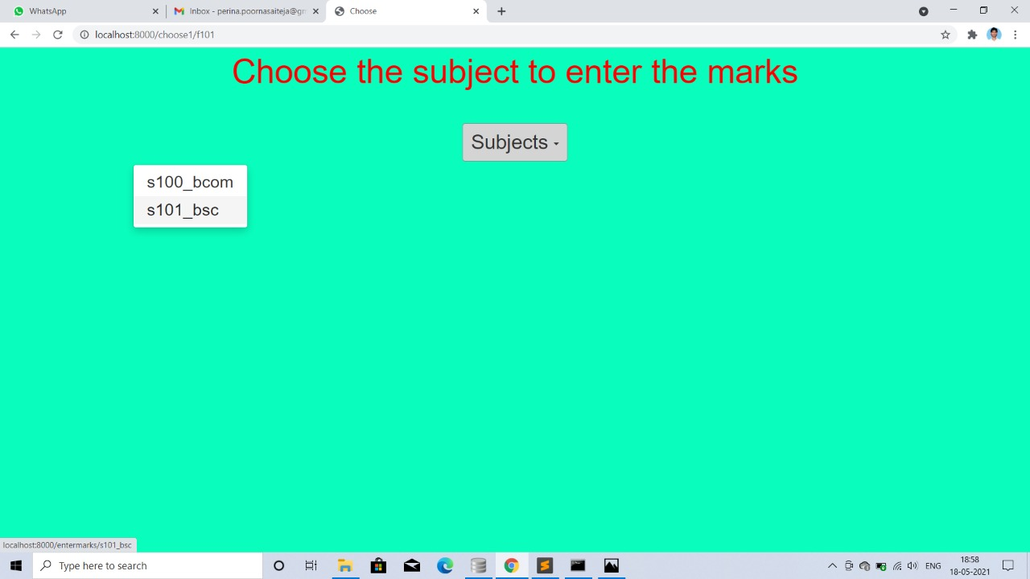

Slide 28
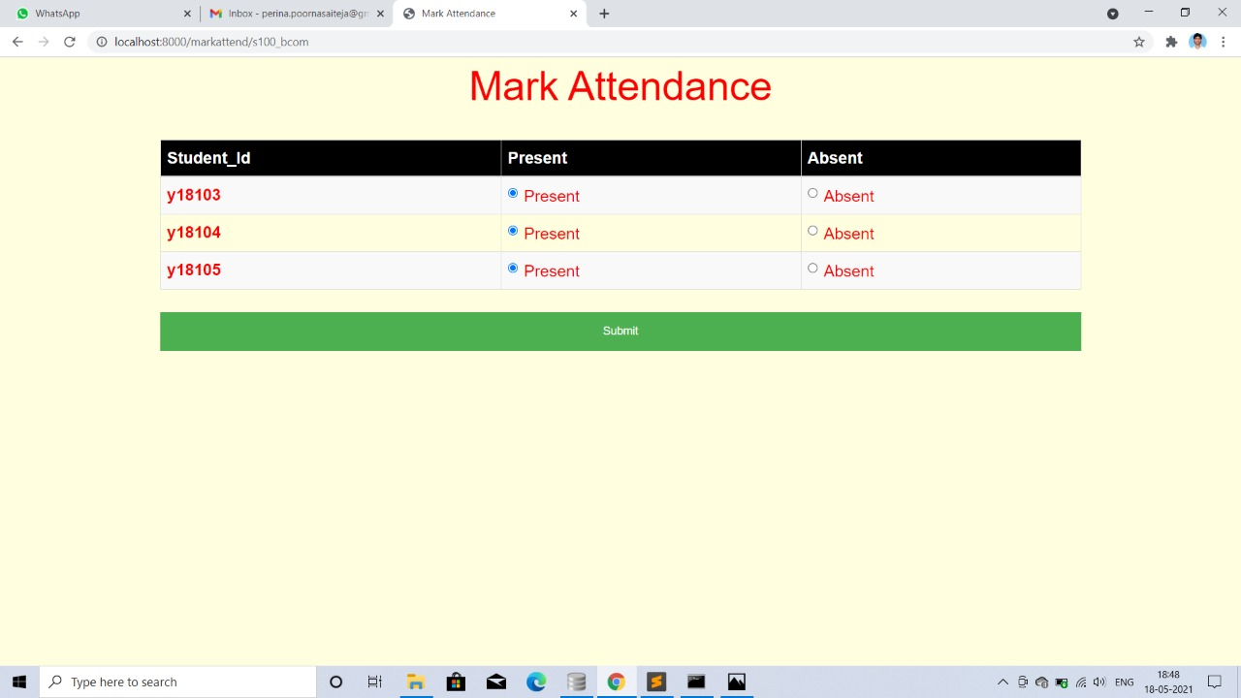

Slide 30
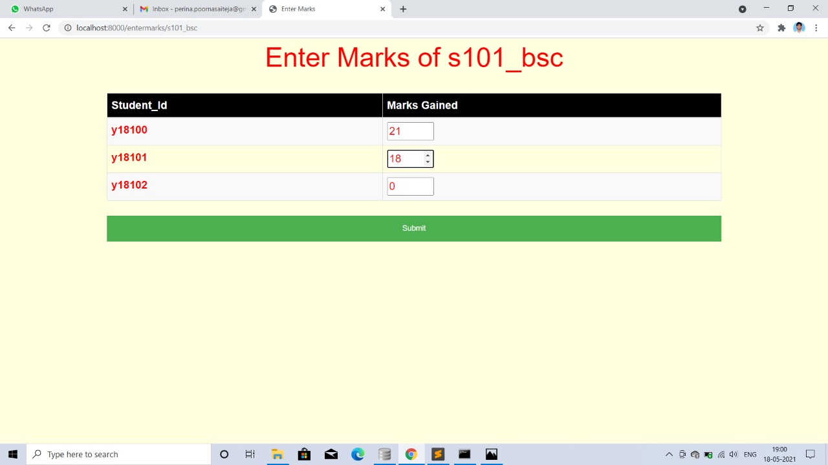

Slide 31


Slide 32
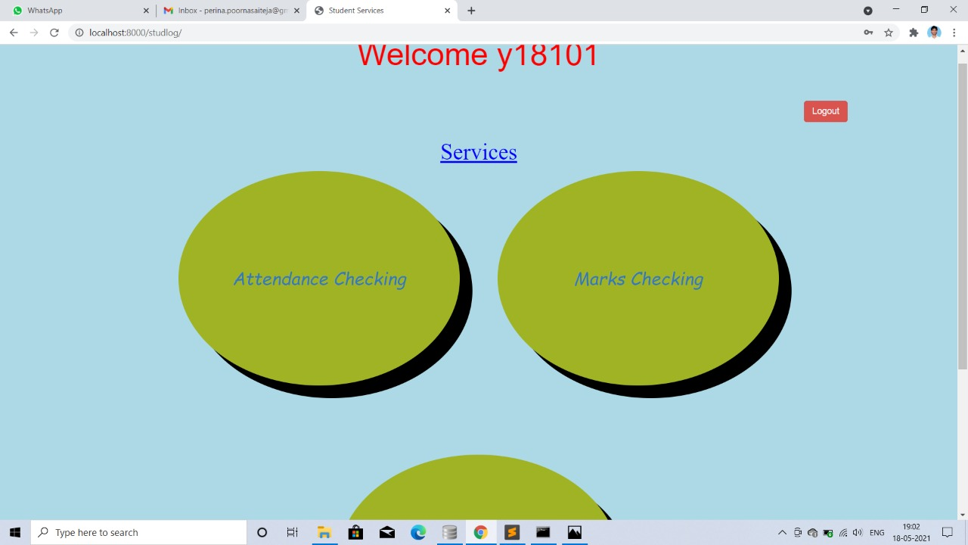

Slide 33
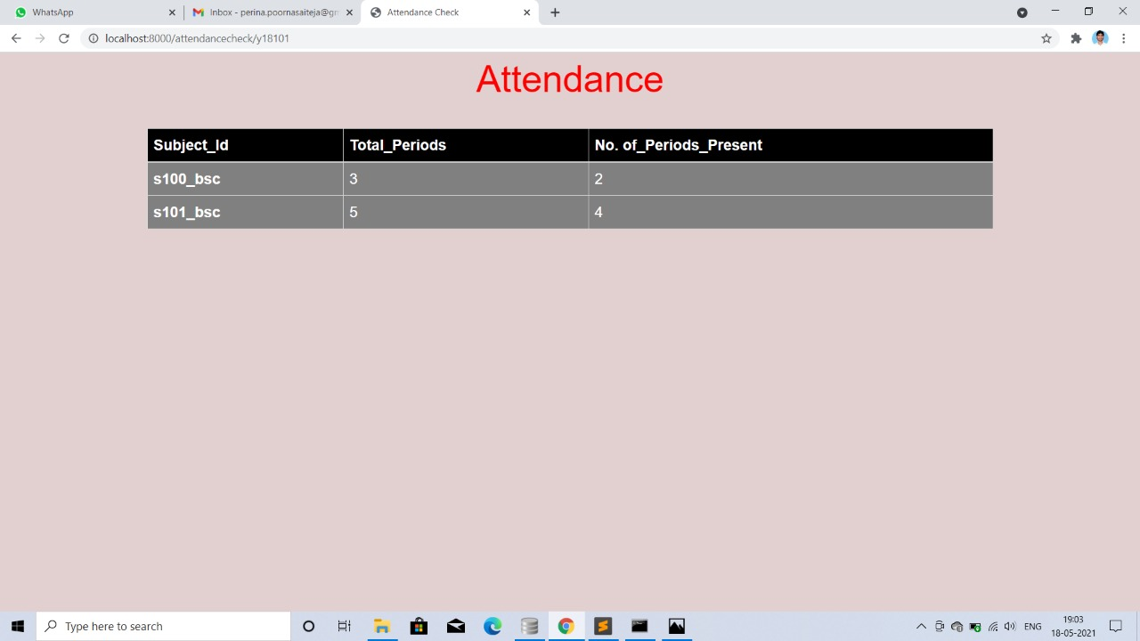

Slide 34
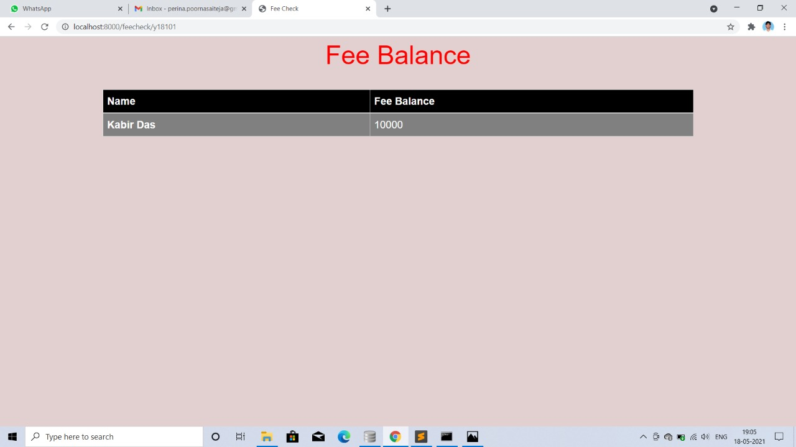

Slide 35
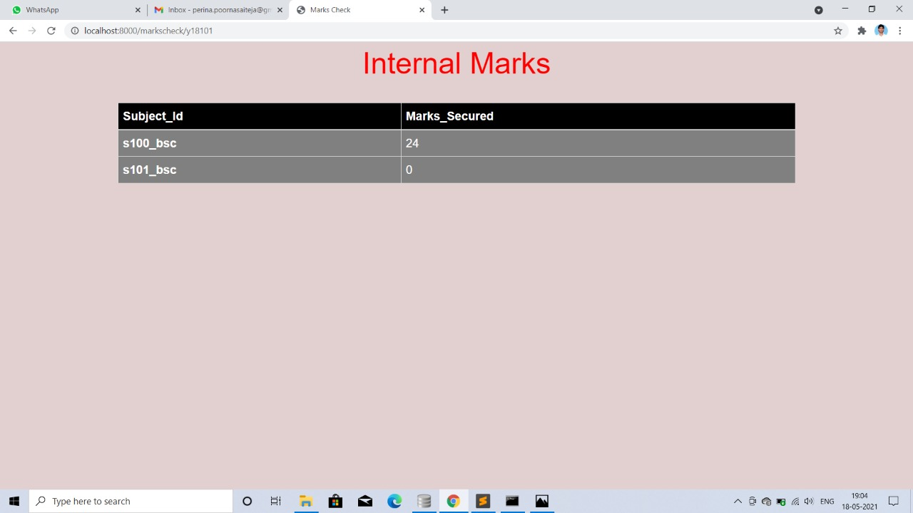

Slide 36
Conclusion
The main agenda of this project is to build effective system which can maintain attendance , marks of students so that it can incorporate any future enhancements.
Students and Staff can easily identify their requirements.
Human prone errors will be minimised.

Slide 37


